Slide 1
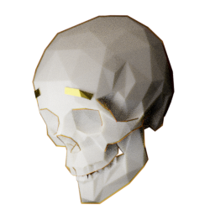
Friendly Skeleton Games

Slide 2
Meet the team
Mason
Leslie
Dani
Natalie
Alec
Cassandra
-Programmer
-Lead designer
-Programmer
-Programmer
-Audio
-Producer
-Artist
-Writer
Notes:
Hello everyone I’m Mason <I’m Natalie>, we are Friendly Skeleton Games. By way of introduction, we have myself, Mason as the lead designer and a programmer, Natalie as the sound designer and producer, Leslie and Dani as programmers, Alec as our artist and Cassandra as our writer. And we would like to present to you…

Slide 3
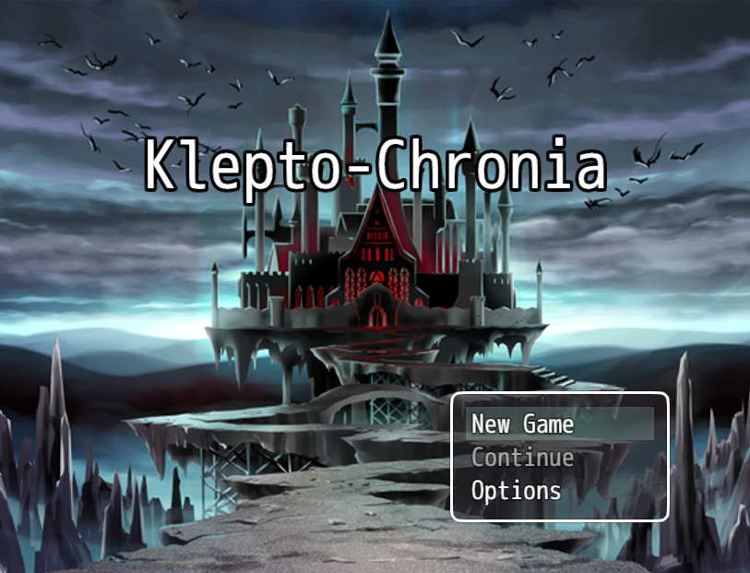
Notes:
Klepto-Chronia. Klepto-Chronia is a time-traveling 2D, top-down, puzzle game built around stealth. As a quick aside, almost none of these images are our own, we have sources listed at the end.

Slide 4
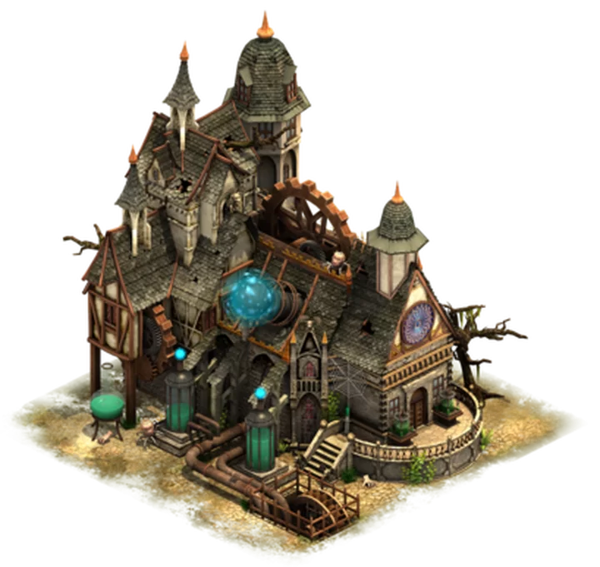

Setting
Notes:
The game is set in the mansion and lab of Dr. Ology, a reclusive science prodigy from the past. His lab is filled with curios and half-finished inventions with a bit of a surreal feel to it.

Slide 5
Player Role
Time travelling thief from the future.
Time machine broke.
Trying to steal a time travel device to return to the future.
Can manipulate time to solve puzzles and avoid danger.
Notes:
The player will take on the roll of a thief traveling back in time who must steal parts of a time machine to return to her own time. She also has a few tricks up her sleeve that we’ll get into in a moment.

Slide 6
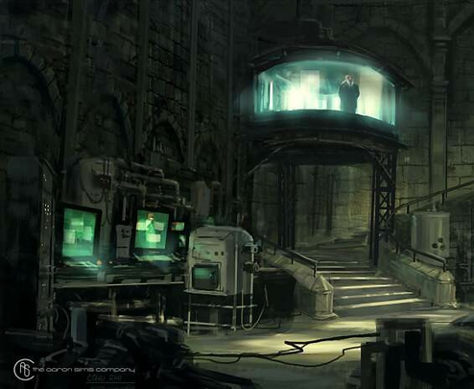
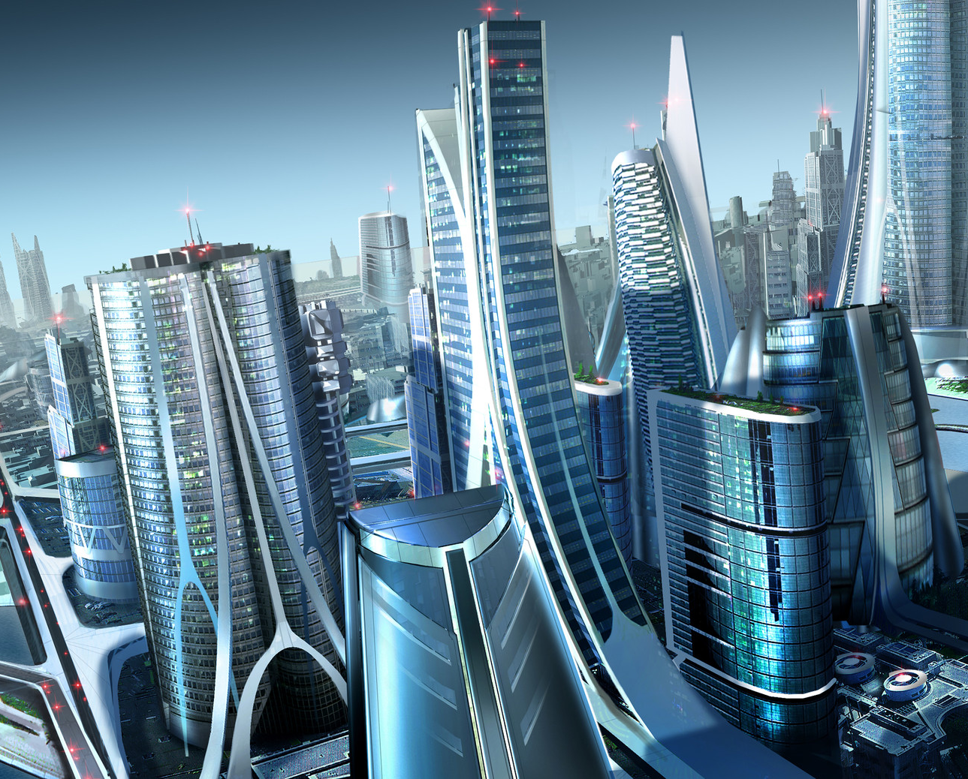
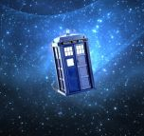
Core Game Objectives
Explore lab
Find time machine
Return to future
Notes:
The core of this game is the exploring of the lab, finding the necessary time device, and safely returning to the future, all without being caught.

Slide 7
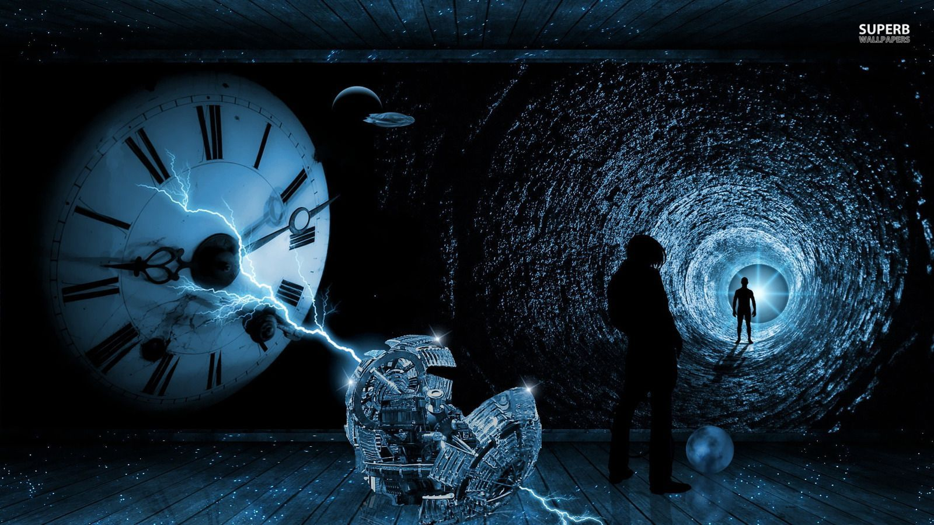
Target Audience
Fans of :
Sci-Fi
Retro-Futurism
Puzzles
Notes:
Because of these things, this game will be perfect for people who like sci-fi and retro-futurism, and will be especially satisfying for puzzle lovers.

Slide 8
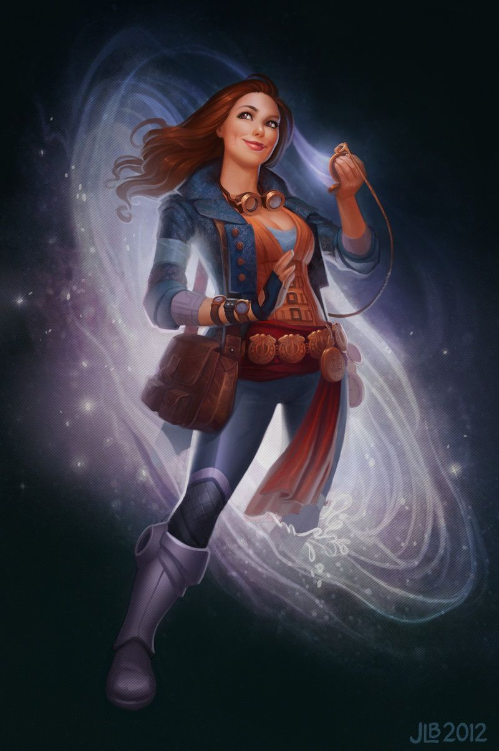
Main Character: Amelia
The player character.
Easily flustered.
Socially oblivious.
Sarcastic.
Notes:
Now a quick introduction to our characters: First up the the protagonist, Amelia. She is the player character, and, while competent, can get flustered easily, be a bit oblivious and quite sarcastic.

Slide 9

Sidekick: Delphi
NPC, Narrator, Amelia’s Partner
Charming.
Teasing.
Helpful
Notes:
Next up is Amelia’s partner Delphi. In contrast to Amelia, Delphi is charming, teasing, and generally helpful. She will act as the narrator and guide for much of the story.

Slide 10
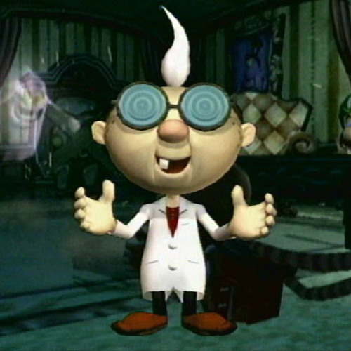
Main Antagonist: Dr. Ology
Mad scientist archetype
Owner of the mansion
Close to unraveling time travel
Notes:
Finally we have our antagonist, Dr. Ology. Dr. Ology is quite the mad scientist. He also happens to be the owner of the mansion lab to which the player is breaking in, since he is suspiciously close to discovering the secrets of time travel for himself.

Slide 11
Unique Feature - Time Stop
Notes:
So what makes this game truly unique? We’re calling it a time bubble.

Slide 12
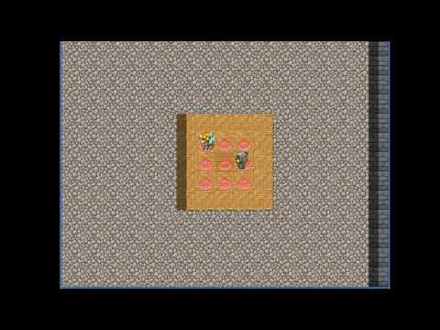
Time Stop Demo
Notes:
While she has no combat abilities, Amelia does have the rather handy ability to freeze time in a small area around her thanks to her gadgets from the future. This is just a quick demo we made of what it could look like in-game.

Slide 13
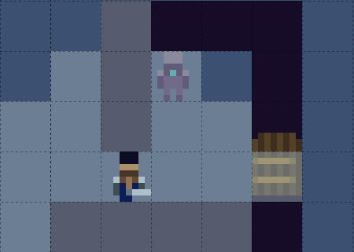
Time Stop - Simple Uses
Notes:
This mechanic has a few obvious uses in a stealth game, with the most simple being the ability to sneak past enemies without being spotted.

Slide 14
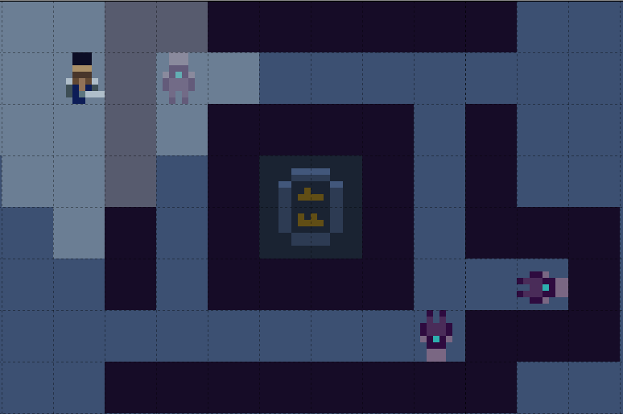
Time Stop - More Advanced
Notes:
There are a few more complex ways to use this ability, such when the pathing of enemies makes it hard to get past them, being able to freeze an enemy in place for a time to disrupt it’s patrol and give yourself an opening to sneak past.

Slide 15
So tell me more about the actual “game” part of this?

Slide 16
Game Mechanics
Walk up, down, left, and right
Time stop
Buttons
Guards
Moving blocks
Collectibles

Slide 17
Game Dynamics
Buttons
Time stop
Enemies and traps
Set checkpoints
Reset to a checkpoint
Collectibles
Notes:
Buttons can be stepped on for an effect.
Time freeze can freeze the state of affected objects.
Enemies and traps can reset player progress if player is caught.
Player can save at set checkpoints placed throughout the game.
Time reverse can reset to a checkpoint if player gets stuck.
Player collects time crystal shards to unlock other areas and progress through the game.

Slide 18
Game Aesthetics
Vulnerability - lack of attacks
Empowerment - abilities
Satisfaction - puzzles
Curiosity - setting
Humor - characters
Notes:
Vulnerability: The player has no way to fight back and must outsmart confrontation. This ties in with:
Empowerment: The player’s abilities are fantastical and allow the player to overcome obstacles.
Satisfaction: Puzzles are hard but rewarding.
Curiosity: The setting is intricate and interesting with lots of hidden stuff.
Humor: Interactions between characters, as well as the PC’s sarcasm/obliviousness.

Slide 19
Development Risks
Big scope potential
Time stopping requires a lot of considerations
Notes:
Big scope potential
Lots of potential spriting
Time stopping is hard
What happens when something is frozen / unfreezes
Have to balance it so it is fun to use and easy to understand.

Slide 20
Question Time!

Slide 21
Sources
Time Traveler for IFX by JessiBeans on DeviantArt - https://www.deviantart.com/jessibeans/art/Time-Traveler-for-IFX-338336581
Sci-Fi Fantasy character concepts by CpnTuttle - https://imgur.com/6hgOiKm
Time Travel Wallpaper by WallpaperAccess - https://wallpaperaccess.com/time-travel
Dio time stop gif from Jojo’s Bizarre Adventure: Stardust Crusaders
Tardis - Dr. Who
Title Screen - RPG Maker MV
8x8 Tileset by Soundlust - https://opengameart.org/content/8x8-tileset-by-soundlust
Professor E. Gadd - Luigi’s Mansion
SciFi Futuristic City - Rob Brown - https://www.artstation.com/artwork/xBglY

Slide 22
Sources continued
Laboratory Concept Art - Aaron Sims Creative - https://www.artstation.com/artwork/oO8GDO
Mad Scientist’s Lab - Forge of Empires - https://forgeofempires.fandom.com/wiki/Mad_Scientist%27s_Lab
Mad scientist - https://media.istockphoto.com/photos/mad-scientist-picture-id169944301?k=20&m=169944301&s=612x612&w=0&h=l-QPi_wQkw7Ow_uqw5R_Fb1sLaF31jQLmKrchLvKBQY=

